Slide 1

FPT University
Android programMing
Lesson 20
Version 1.0

Slide 2
Agenda
The Elements of the Google Maps API
Obtaining Your Developer Signature
Displaying the User’s Current Location
Handling Map Gesture Interaction
Creating Map Markers
Controlling the Map Camera

Slide 3
The Elements of the Google Maps API
The Google Maps Android API consists of a core set of classes that combine to provide mapping capabilities in Android applications. The key elements of a map are as follows:
GoogleMap MapView SupportMapFragment Marker | UiSettings Shapes My Location Layer
Notes:
API = Application Programming Interface
· GoogleMap – The main class of the Google Maps Android API. This class is responsible for downloading and displaying map tiles and for displaying and responding to map controls. The GoogleMap object is not created directly by the application but is instead created when MapView or MapFragment instances are created. A reference to the GoogleMap object can be obtained within application code via a call to the getMap() method of a MapView, MapFragment or SupportMapFragment instance. · MapView - A subclass of the View class, this class provides the view canvas onto which the map is drawn by the GoogleMap object, allowing a map to be placed in the user interface layout of an activity. · SupportMapFragment – A subclass of the Fragment class, this class allows a map to be placed within a Fragment in an Android layout. · Marker – The purpose of the Marker class is to allow locations to be marked on a map. Markers are added to a map by obtaining a reference to the GoogleMap object associated with a map and then making a call to the addMarker() method of that object instance. The position of a marker is defined via Longitude and Latitude. Markers can be configured in a number of ways, including specifying a title, text and an icon. Markers may also be made to be “draggable”, allowing the user to move the marker to different positions on a map. · Shapes – The drawing of lines and shapes on a map is achieved through the use of the Polyline, Polygon and Circle classes. · UiSettings – The UiSettings class provides a level of control from within an application of which user interface controls appear on a map. Using this class, for example, the application can control whether or not the zoom, current location and compass controls appear on a map. Th WOW! eBook is class can www.wowebook.org also be used to configure which touch screen gestures are recognized by the map. · My Location Layer – When enabled, the My Location Layer displays a button on the map which, when selected by the user, centers the map on the user’s current geographical location. If the user is stationary, this location is represented on the map by a blue marker. If the user is in motion the location is represented by a chevron indicating the user’s direction of travel.

Slide 4
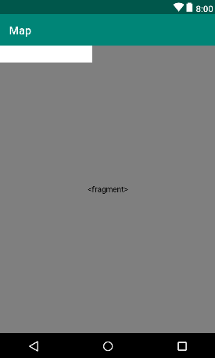
Obtaining Your Developer Signature
Creating the Google Maps Project

Slide 5
Obtaining Your Developer Signature
Before an application can make use of the Google Maps Android API, it must first be registered within the Google APIs Console.
In order to obtain Google API key, Android Studio adds some additional files to the project to make it easier. The link to get Google API key include in google_maps_api.xml

Slide 6
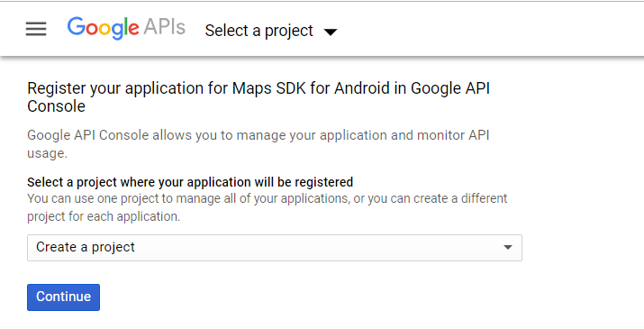
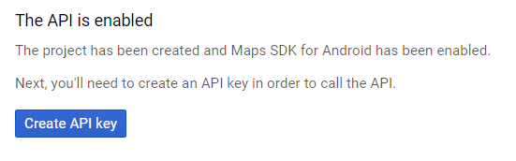
Obtaining Your Developer Signature

Slide 7
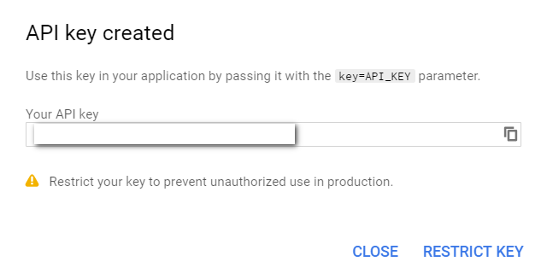
Obtaining Your Developer Signature
Copy this key, return to Android Studio and paste the API key into the YOUR_KEY_HERE section of the file:
<string name="google_maps_key"
templateMergeStrategy="preserve" translatable="false">
YOUR_KEY_HERE
</string>

Slide 8
Obtaining Your Developer Signature
Testing the Application

Slide 9
Displaying the User’s Current Location
Collect user’s location is a dangerous permission, so that we need to request permission for this task.
<uses-permission
android:name="android.permission.ACCESS_FINE_LOCATION" />

Slide 10
Displaying the User’s Current Location
Get user’s current location
private final int LOCATION_REQUEST_CODE = 100; @Override public void onMapReady(GoogleMap googleMap) { mMap = googleMap; if(mMap != null){ int permission = this.checkSelfPermission(Manifest.permission.ACCESS_FINE_LOCATION); if(permission != PackageManager.PERMISSION_GRANTED){ ActivityCompat.requestPermissions(this, new String[]{Manifest.permission.ACCESS_FINE_LOCATION}, LOCATION_REQUEST_CODE); } else { mMap.setMyLocationEnabled(true); } } }

Slide 11
Displaying the User’s Current Location
Handle on resquest permission
@Override public void onRequestPermissionsResult(int requestCode, String[] permissions, int[] grantResults) { if(grantResults.length == 0 || grantResults[0] != PackageManager.PERMISSION_GRANTED ){ Toast.makeText(this,"Unable to show location - permission required", Toast.LENGTH_LONG).show(); } else{ SupportMapFragment supportMapFragment = (SupportMapFragment)getSupportFragmentManager().findFragmentById(R.id.map); supportMapFragment.getMapAsync(this); } }

Slide 12
Displaying the User’s Current Location
Map Type The type of map displayed can be modified dynamically by making a call to the setMapType() method of the corresponding GoogleMap object, passing through one of the following values
· GoogleMap.MAP_TYPE_NONE
· GoogleMap.MAP_TYPE_NORMAL
· GoogleMap.MAP_TYPE_SATELLITE
· GoogleMap.MAP_TYPE_HYBRID
· GoogleMap.MAP_TYPE_TERRAIN
Notes:
· GoogleMap.MAP_TYPE_NONE – An empty grid with no mapping tiles displayed. · GoogleMap.MAP_TYPE_NORMAL – The standard view consisting of the classic road map. · GoogleMap.MAP_TYPE_SATELLITE – Displays the satellite imagery of the map region. · GoogleMap.MAP_TYPE_HYBRID – Displays satellite imagery with the road maps superimposed. · GoogleMap.MAP_TYPE_TERRAIN – Displays topographical information such as contour lines and colors.

Slide 13
Displaying the User’s Current Location
Using Spinner to Changing the Map Type
<?xml version="1.0" encoding="utf-8"?> <FrameLayout android:layout_height="match_parent" android:layout_width="match_parent" xmlns:android="http://schemas.android.com/apk/res/android" xmlns:tools="http://schemas.android.com/tools" xmlns:map="http://schemas.android.com/apk/res-auto" tools:context=".MapsActivity">
<fragment android:id="@+id/map" android:name="com.google.android.gms.maps.SupportMapFragment" android:layout_width="match_parent" android:layout_height="match_parent" map:uiZoomControls="true" /> <Spinner android:id="@+id/spinner" android:layout_width="164dp" android:layout_height="35dp" android:background="#dadada"/> </FrameLayout>

Slide 14
Displaying the User’s Current Location
Prepairing data for spinner
<?xml version="1.0" encoding="utf-8"?> <!-- This file is MapType.xml in Value dir --> <resources> <string-array name="Map_Type"> <item>Map type: None</item> <item>Map type: Normal</item> <item>Map type: Satellite</item> <item>Map type: Hybrid</item> <item>Map type: Terrain</item> </string-array> </resources>

Slide 15
Displaying the User’s Current Location
Handle spinner on item selected
Spinner spinner = findViewById(R.id.spinner); ArrayAdapter adapter = ArrayAdapter.createFromResource(this,R.array.Map_Type, android.R.layout.simple_spinner_item); adapter.setDropDownViewResource(android.R.layout.simple_spinner_dropdown_item); spinner.setAdapter(adapter); spinner.setSelection(1); spinner.setOnItemSelectedListener(new AdapterView.OnItemSelectedListener() { @Override public void onItemSelected(AdapterView<?> parent, View view, int position, long id) { mMap.setMapType(position); } @Override public void onNothingSelected(AdapterView<?> parent) { } });

Slide 16
Handling Map Gesture Interaction
Displaying Map Controls to the User The Google Maps Android API provides a number of controls that may be optionally displayed to the user consisting of zoom in and out buttons, a “my location” button and a compass
UiSettings mapSettings; mapSettings = mMap.getUiSettings(); mapSettings.setZoomControlsEnabled(false);
<fragment android:id="@+id/map" android:name="com.google.android.gms.maps.SupportMapFragment" android:layout_width="match_parent" android:layout_height="match_parent" map:uiZoomControls="true" />

Slide 17
Handling Map Gesture Interaction
Map Gesture Interaction
UiSettings mapSettings; mapSettings = mMap.getUiSettings(); mapSettings.setZoomGesturesEnabled(false); mapSettings.setTiltGesturesEnabled(false); mapSettings.setRotateGesturesEnabled(false); mapSettings.setScrollGesturesEnabled(false); mapSettings.setAllGesturesEnabled(false);

Slide 18
Creating Map Markers
Markers are used to notify the user of locations on a map and take the form of either a standard or custom icon
LatLng MUSEUM = new LatLng(21.0104273, 105.540135); mMap.addMarker(new MarkerOptions() .position(MUSEUM) .title("Museum") .snippet("National Air and Space Museum"));

Slide 19
Creating Map Markers
Marker on click
public class MapsActivity extends FragmentActivity
implements OnMapReadyCallback, GoogleMap.OnMarkerClickListener {
googleMap.setOnMarkerClickListener(this);
@Override public boolean onMarkerClick(Marker marker) { movePosition(marker.getPosition(), mMap); return true; }

Slide 20
Creating Map Markers
Move to maker position
public void movePosition(LatLng position, GoogleMap map){ CameraPosition cameraPosition = new CameraPosition.Builder() .target(position) .zoom(50) .tilt(25) .bearing(75) .build(); map.animateCamera(CameraUpdateFactory.newCameraPosition(
cameraPosition)); }

Slide 21
Controlling the Map Camera
Android device screens are flat and the world is a sphere, the Google Maps Android API uses the Mercator projection to represent the earth on a flat surface
camera to be changed in real-time from within the application: · Target · Zoom · Tilt · Bearing
Notes:
camera to be changed in real-time from within the application: · Target – The location of the center of the map within the device display specified in terms of longitude and latitude. · Zoom – The zoom level of the camera specified in levels. Increasing the zoom level by 1.0 doubles the width of the amount of the map displayed. · Tilt – The viewing angle of the camera specified as a position on an arc spanning directly over the center of the viewable map area measured in degrees from the top of the arc (this being the nadir of the arc where the camera points directly down to the map). · Bearing – The orientation of the map in degrees measured in a clockwise direction from North.

Slide 22
Controlling the Map Camera
A summary of CameraUpdateFactory methods is as follows:
CameraUpdateFactory.zoomIn()
CameraUpdateFactory.zoomOut()
CameraUpdateFactory.zoomBy(float)
CameraUpdateFactory.zoomBy(float, Point)
CameraUpdateFactory.newLatLng(LatLng)
CameraUpdateFactory.newLatLngZoom(LatLng, float)
CameraUpdateFactory.newCameraPosition(CameraPosition)
Notes:
A summary of CameraUpdateFactory methods is as follows: · CameraUpdateFactory.zoomIn() – Provides a CameraUpdate instance zoomed in by one level. · CameraUpdateFactory.zoomOut() - Provides a CameraUpdate instance zoomed out by one level. · CameraUpdateFactory.zoomOut() - Generates a CameraUpdate instance that changes the zoom level to the specified value. · CameraUpdateFactory.zoomBy(float) – Provides a CameraUpdate instance with a zoom level increased or decreased by the specified amount. · CameraUpdateFactory.zoomBy(float, Point) - Creates a CameraUpdate instance that increases or decreases the zoom level by the specified value. · CameraUpdateFactory.newLatLng(LatLng) - Creates a CameraUpdate instance that changes the camera's target latitude and longitude. · CameraUpdateFactory.newLatLngZoom(LatLng, float) - Generates a CameraUpdate instance that changes the camera's latitude, longitude and zoom. · CameraUpdateFactory.newCameraPosition(CameraPosition) - Returns a CameraUpdate instance that moves the camera to the specified position. A CameraPosition instance can be obtained using CameraPosition.Builder().

Slide 23
Testing appication

Slide 24

End of Lesson 20

Slide 25
Thank you!

